Slide 1


Pathfinding and Haptic Feedback within Dynamic 3D Environments
Noah Wyborny

Slide 2


Introduction
Haptics may allow for navigation without the need of audio-visual stimuli.
By applying haptic effects, we may be able to determine potential paths from a start to an end goal.

Slide 3
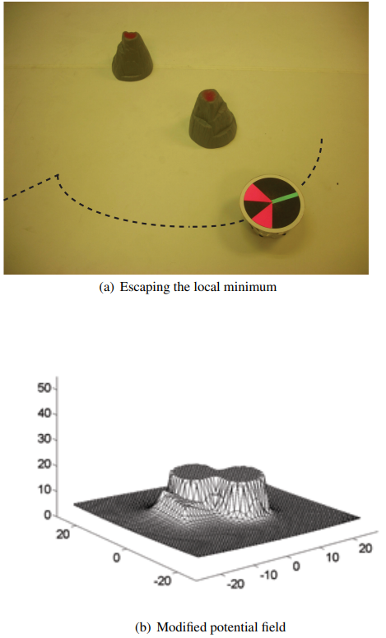
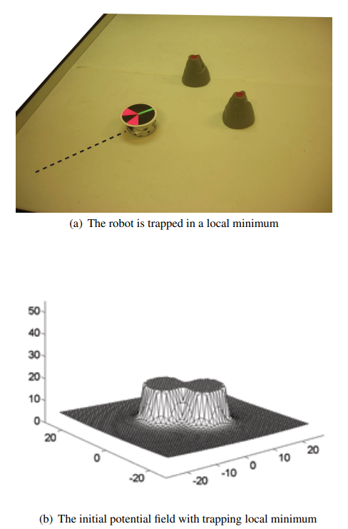
Walker et al use potential fields in order to act as a “force-field” for robot navigation. If applied similarly to haptic devices, it may be able to be used for human-agent navigation as well.

Slide 4
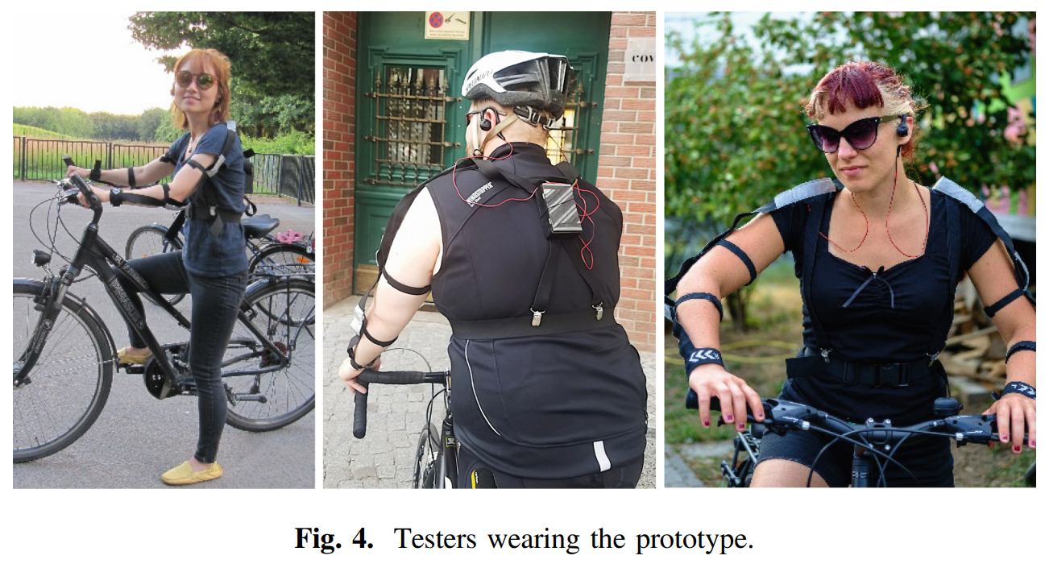
Giesa used haptic devices for urban navigation to good effect, in combination with audio cues.

Slide 5


Methods
Pathfinding
A*
Randomly selected spawn locations
Haptic
Friction as force feedback
Treatments
Control
Haptic
Visual
Visuo-Haptic

Slide 6
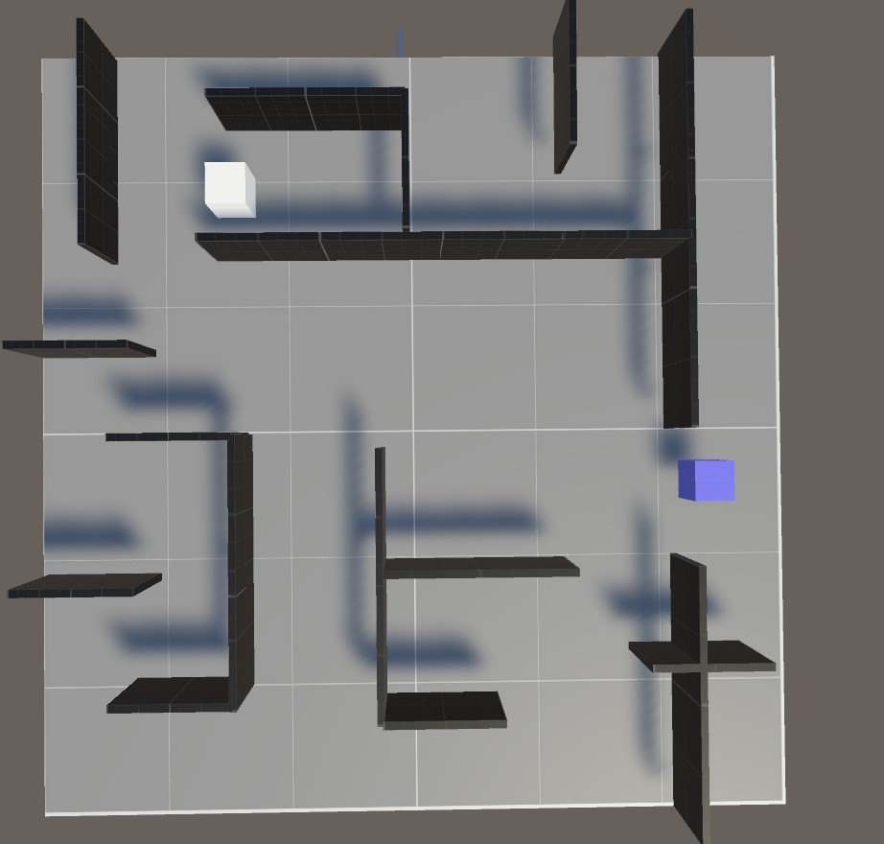
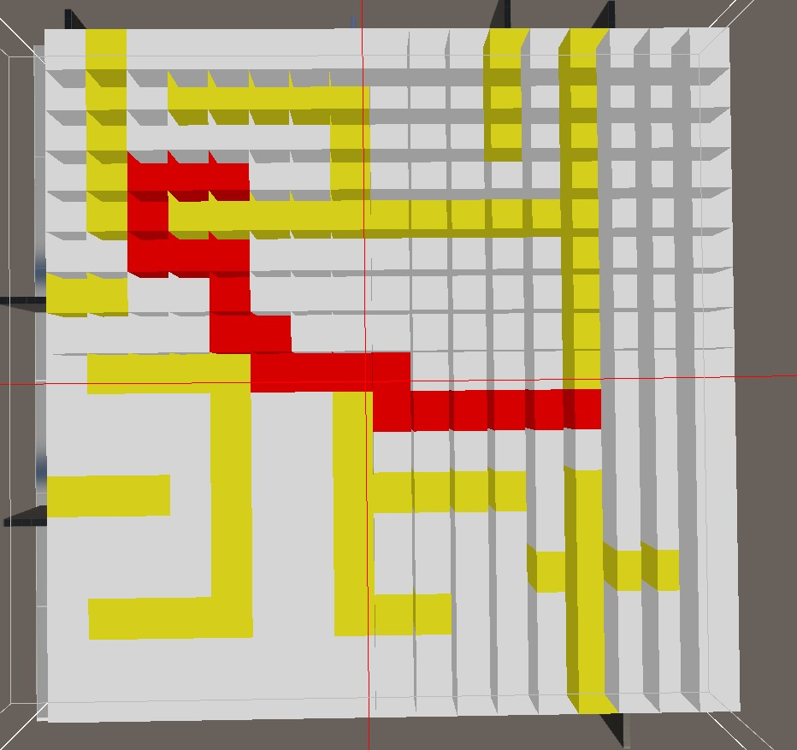

Slide 7
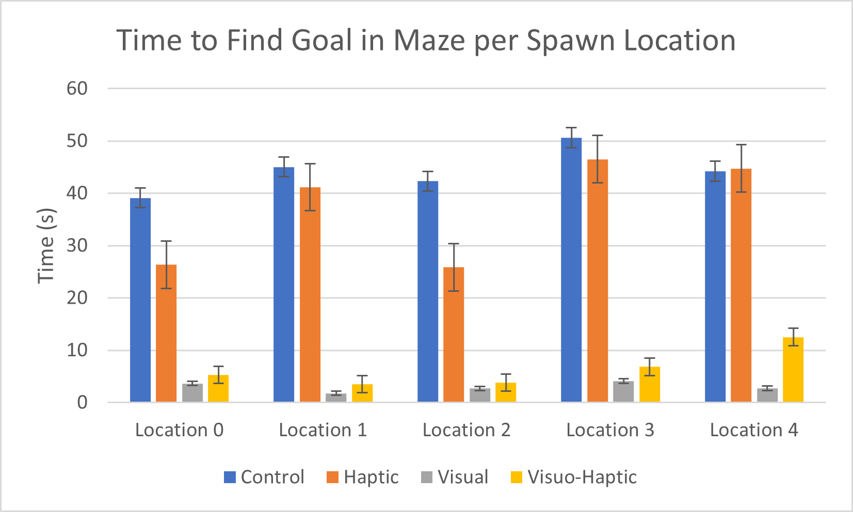
Results
Haptic feedback may be sufficient for navigation within a simulated environment.
P-Value of 0.0397 for T-Test between Control and Haptic treatment. As such we reject the null hypothesis.

Slide 8
Conclusion
Haptic effect may be sufficient for navigation
Study was small in size, with 3 participants
Further study is needed to determine feasibility for larger populace

